Slide 1


Deep Learning based Approach to Range Regression
V. Adithya Krishnan
Anurag Shukla
Samvram Sahu
Guided by - Dr. Deepak Mishra, Shri Pradipta Roy

Slide 2
AIM
Given a frame depicting a missile in flight from an EOTS,
Predict the range of the flight vehicle within certain bounds of error.

Slide 3
Relevance of the Topic
Absolutely new domain, we need to create our own dataset, hence novelty from the roots.
This is what the country’s prime Defence organization prioritized.
From cleansing and pre-processing the data to establishing results, we provided a test-bed.
Blooming Area, DARE(Defence Avionics Research Establishment) is looking into our work as we speak.

Slide 4
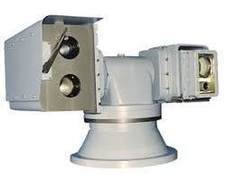
Defining EOTS
(Electro Optical Tracking System)
EOTS
Tracked video
Azimuth, Elevation of flight vehicle
IR feed

Slide 5

Workflow
Site 1
Tracking the object in FOV
EOTS 1
R: 23405 m
DownLink
Tracking
Geometric
methods
CDP
EOTS 2
Azimuth, Elevation, Timestamp to base
Site 2

Slide 6
Causes of failure
Site 1
Failure in Tracking due to clouds
EOTS 1
R: 23405 m
Loss of Tracking
Downlink
failure
2 sensors
required
CDP
EOTS 2
Wrong timestamp sync b/w 2 sites
Site 2

Slide 7
Methods at our disposal
Geometric calculation(Monocular Vision) - Deterministic method
Machine Learning
Linear Regressor
SVM regressor
MLP regressor
Deep Learning(CNNs)

Slide 8

Monocular
Vision
Digital (CMOS) Camera used for taking pictures from which depth map is estimated

Slide 9
Some groundwork
Using geometrical relations and pinhole camera approximations we have,
Fixed camera pose, and position; i.e. we know the camera’s position, height and angle of depression of the optical axis.
Also given the focal length of the lens of the camera, and resolution of the image taken,
We can approximate the position of the object in cartesian coordinate. Codes have been written that return values in accuracy of 98% and above for ranges <2m.

Slide 10
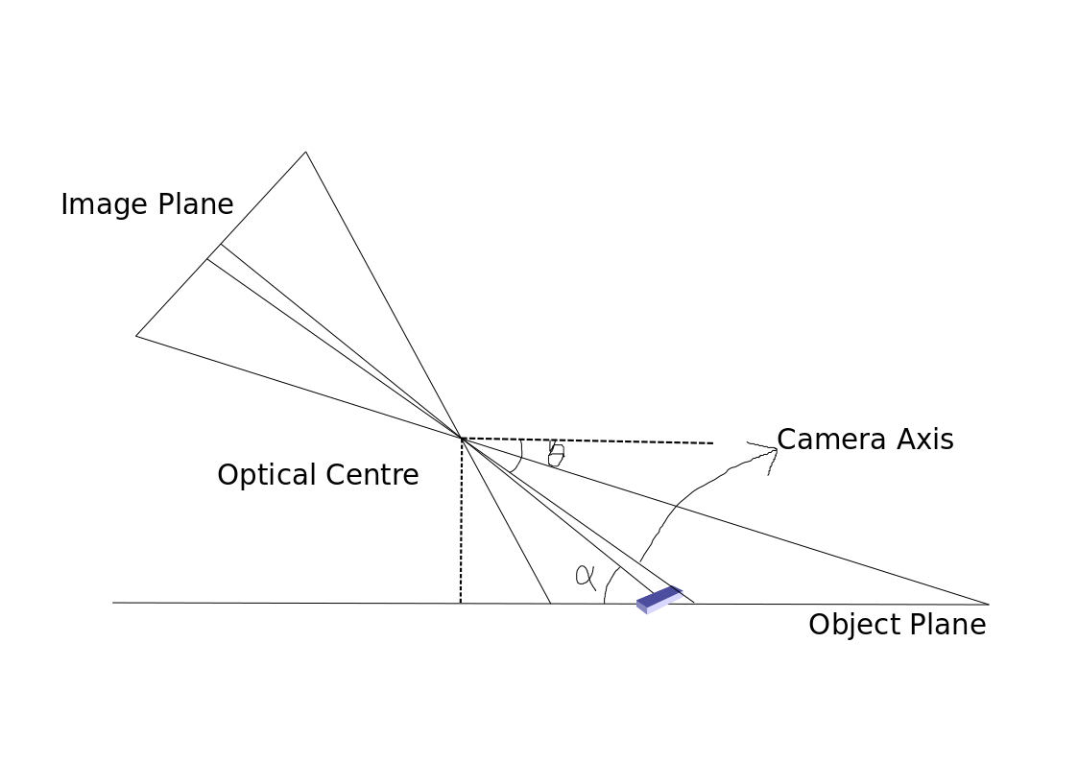
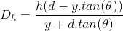
Theory
Arrangement of Apparatus for the Experiment
y
d
h
Dh

Slide 11
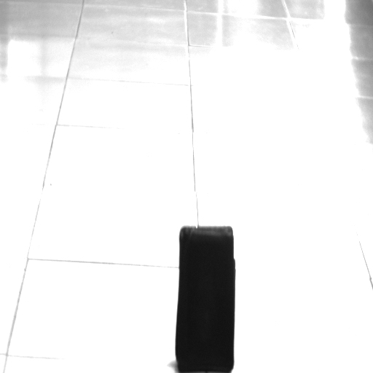
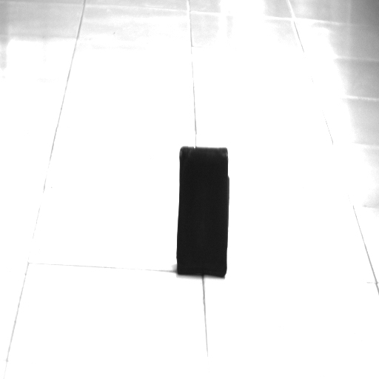
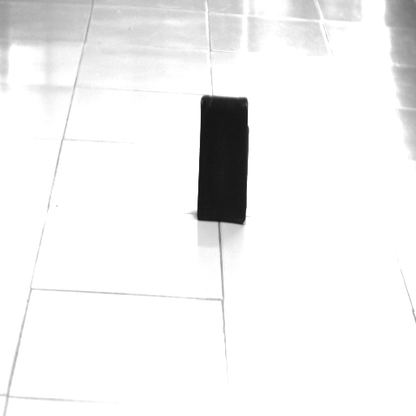
How did we do it?
Take images with various ranges

Slide 12
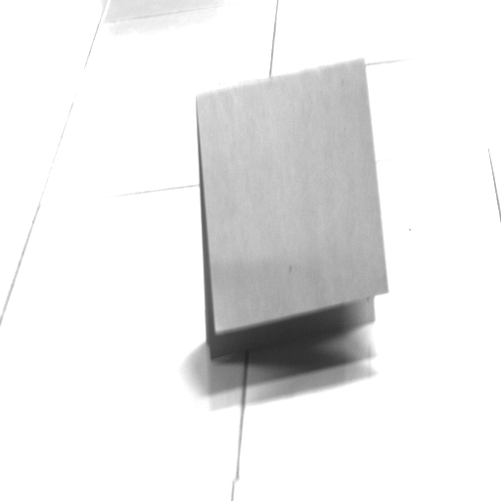
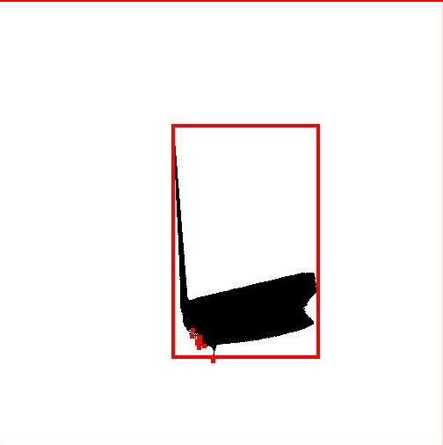
Segment the image: Thresholding (OTSU)

Slide 13
An example
Threshold the image - Segmentation
Compute the centroid or the centre of an edge, in this case centre of the bottom edge
Calculate y from the image
With other given parameters in the previous equation estimate the range Dh.
y

Slide 14
Key results
Actual Range | Predicted Range
1.59 m | 1.581 m
1.46 m | 1.432 m
1.40 m | 1.396 m
2.00 m | 1.894 m
4.50 m | 3.362 m

Slide 15
Problems
Only applicable in 2D plane.
The accuracy suffers a lot of damage for range>3m
The results depend a lot on parameters that can be hidden, i.e. shape and size.
Error diverges when the value of R increases.

Slide 16
Statistical Methods
Where to begin?

Slide 17
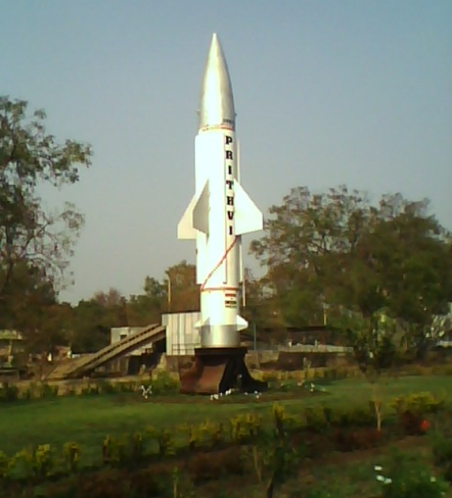
Prithvi = Dataset!

Slide 18

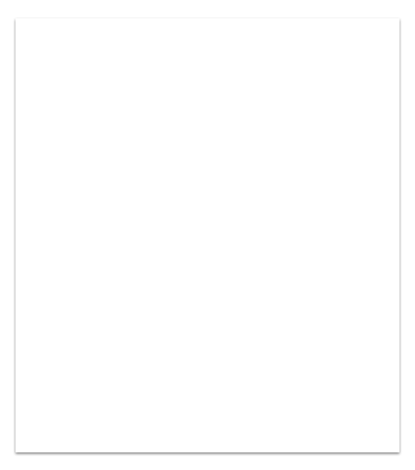
Dataset
Creating a new Dataset
From? Tracked videos with annotations (EOTS output).
How?
Extract range - ROI based OCR
Filter range data
Make a dataset
Why?
No previous data available

Slide 19
Construction of the Dataset
Given a video as an input, extract frames.
Construct an array of structure, where each structure contains a frame and its corresponding range (extracted from annotation) in the frame as elements.
Now separate the elements into arrays and filter the range which is unacceptable.
Also, the values which are ill poised are corrected using a filter designed by DRDO
The dataset is now formed by separating them into two arrays of Images and Range

Slide 20

Practical insight
An annotated video is the input, where we extract each frame as a datapoint.

Slide 21
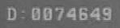
Practical insight
Problems encountered:
Bad stamping - Line Errors
Intensity values of font and background were same
ROI might change
0 , 8 are almost matched as the same
From each frame the Range is Extracted from the annotation at the bottom right corner.

Slide 22
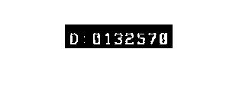
Practical insight
Segmentation technique:-
OTSU’s technique FAILS!
Sample the digit pixel value
Use Region Growing to enhance
Threshold the ROI
Now that portion or Region Of Interest (ROI) is segmented.

Slide 23
Practical insight
How do we separate into digits:
Keep summing over y, moving along x
Where the sum over y for given x is 0, is end of an digit
Separate and start looking till the sum is positive.
Again segregate once sum is 0
Template making
The target for training is in this ROI and hence we need to convert this into meaningful range.

Slide 24
Practical insight
D : 0132570
Use Template matching as,
Always same font is used
At the same scale
At the same position
All these favour the above

Slide 25
Choose Machine Learning or Deep Learning?
Use both, compare and find the better fit!

Slide 26
Approach
Regressors
Manual Feature based
Auto feature extracted
Linear Regressor
Tree Regressor
CNNs
R-CNNs
SVM
ANN

Slide 27
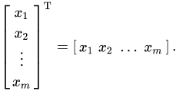
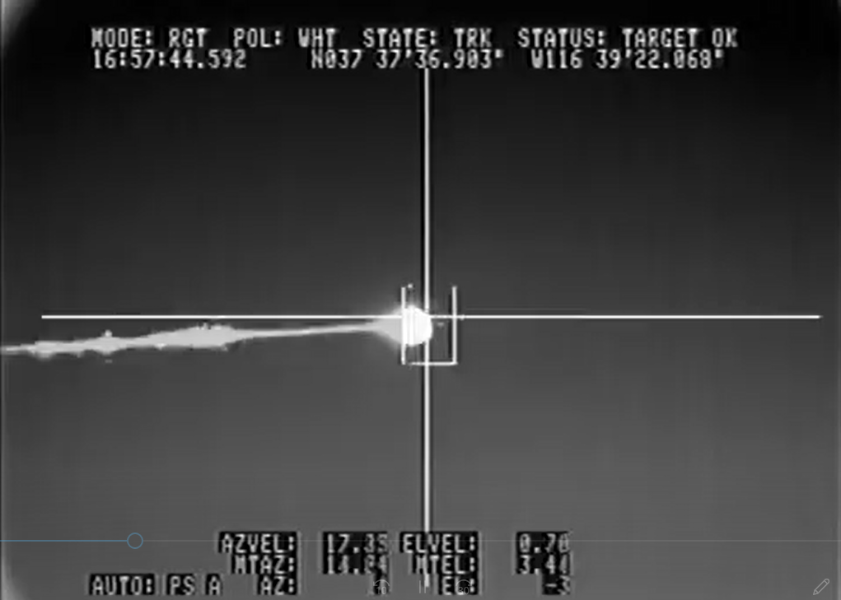
Practical insight
We have the training data, and also targets we need to transform the images to feature vector, i.e. we need to manually extract features.
Regressor Design

Slide 28
Practical insight
What are the features we have used:
Size of the object
Average Intensity of the object
Relative Intensity of the object
Eccentricity of the object
Feature Extraction

Slide 29
Practical insight
‘f’ is the regressor,
‘Fv’ is the Feature Vector
We need to find an optimal ‘f’
Regressor design
Feature vector
Range
Regressor

Slide 30
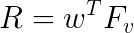
Practical insight
‘w’ is the weight matrix,
‘Fv’ is the Feature Vector
We need to find an optimal ‘w’
RMSE = 25.086 km
Linear Regression
Feature vector
Range
Regressor

Slide 31
Practical insight
A generic algorithm has been used
RMSE = 23.108 km linear
RMSE = 21.186 km nonlinear
SVM Regression
Feature vector
Range
SVM
Regressor

Slide 32
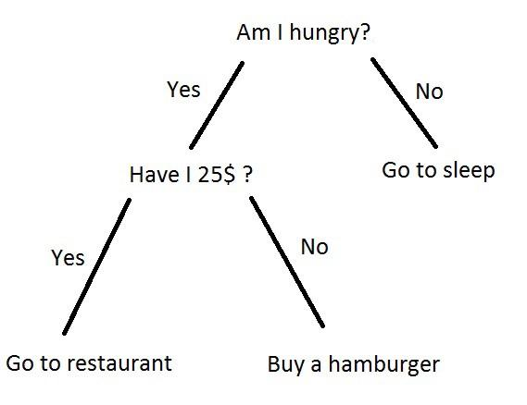
Practical insight
RMSE = 4.1946 km
Divides the problem space into regions in which the data is linearly separable, and implements a linear classifier in each interval.
Decision Tree Regression
Feature vector
Range
Tree
Regressor

Slide 33
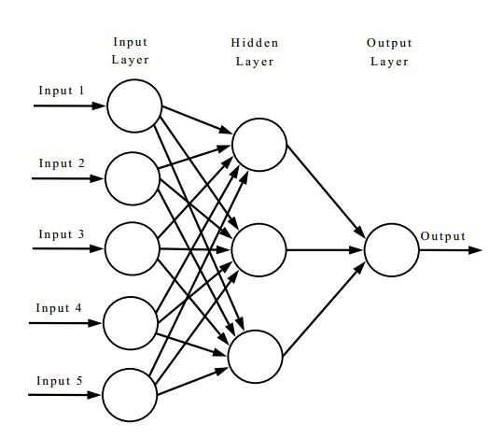
Practical insight
RMSE = 9.3901 - 10 Neurons
RMSE = 8.0328 - 15 Neurons
RMSE = 7.0915 - 20 Neurons
RMSE = 8.3112 - 100 Neurons
ANN Regression
Feature vector
Range
ANN
Regressor

Slide 34

CNNs for Regression
CNNs eliminate the need for manual feature extraction—the features are learned directly by the CNN.
CNNs have been known to produce state-of-the-art recognition results.
CNNs can be retrained for new regression tasks, enabling you to build on pre-existing networks.
Is it still worth the complexity? Let’s find out

Slide 35
Training Data Validation Data
4760/6800 samples in the dataset are assigned as the training data, on which the network/regressor - 70 % split( 60 % training - 10 % validation)
Test Data
2040/6800 samples are used as test data, for validation purposes.
Special care is taken that the data is uniformly distributed in both the cases.

Slide 36
Architecture
Neural Network’s structure
Deep Learning? Need to see results to see if it is required
How?
Design each layer
Compatibility of adjacent layers
Decide how deep
Why?
Parameters affect accuracy

Slide 37
Hyperparameters
Various parameters to play with
Network Architecture Number of layers, Arrangement of layers
Learning Rate How fast the weights change to converge
Regularization Dropouts help network avoid overfitting

Slide 38
Constraint one:
Ratio of real filter size to receptive field size is
greater than ⅙.
Information
The receptive field is defined as the region in the input space that a particular CNN’s feature is looking at (i.e. be affected by).

Slide 39
Another one!
The receptive field size of the last neuron should
not be the whole img.
Fact
Each successive layer in CNN is capable of learning increasingly abstract features of the original image due to its unique features in receptive field.

Slide 40
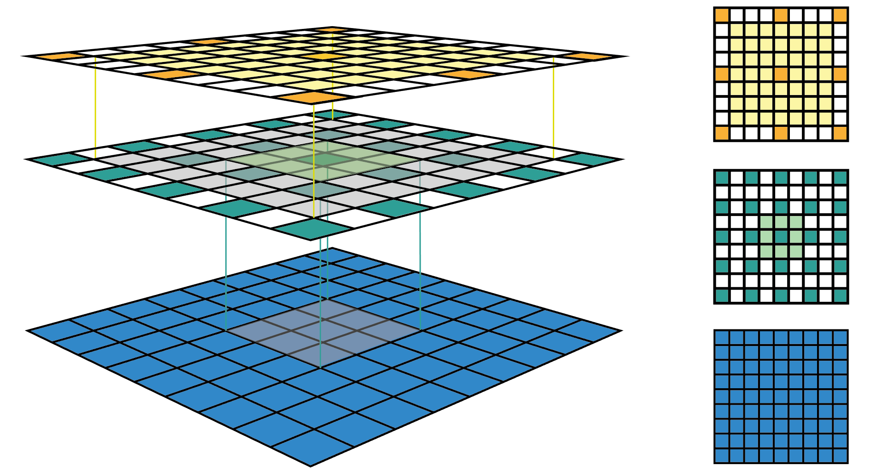
Network - I
Image Input Layer(152x152)
Convolution Layer(3x3, 1)
ReLU Layer
Normalization Layer
Average Pooling Layer
Fully Connected Layer
Regression Layer
3

Slide 41
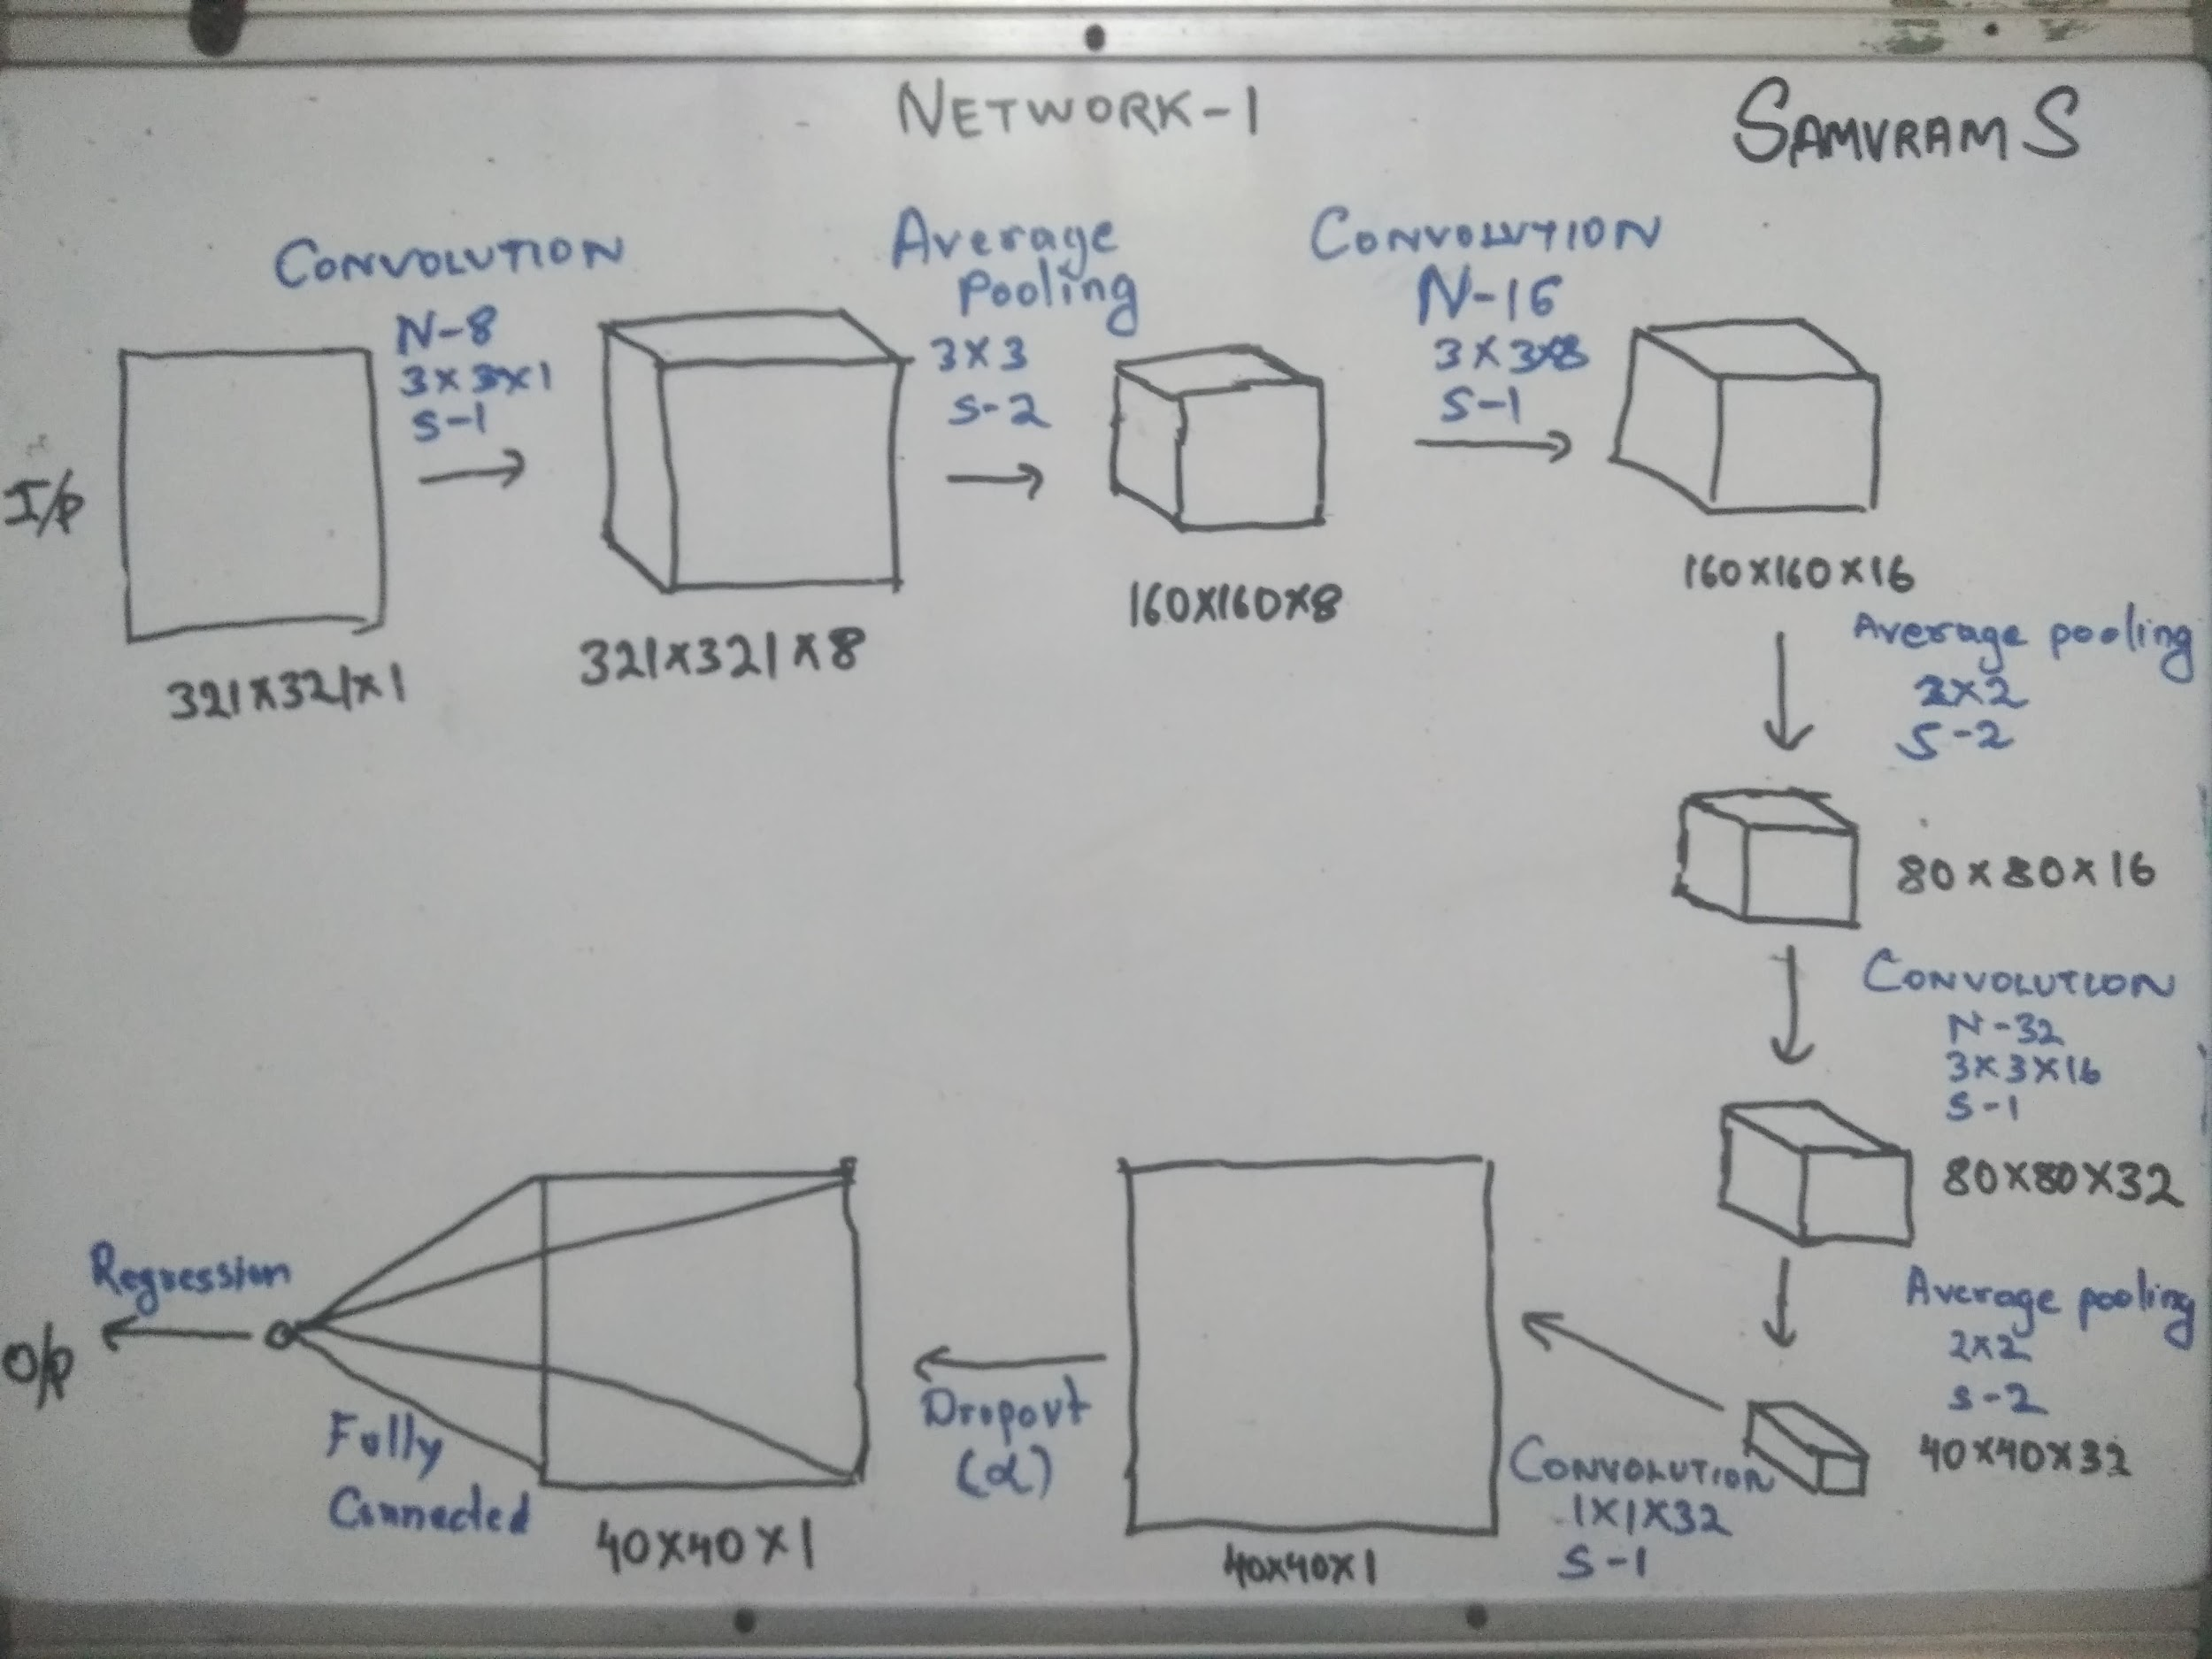

Slide 42
Network - 1
A crude architecture made for making it a starting point.
Combination of Convolution, Normalization and ReLU layer with avg pooling layer is a stable architecture backbone.
Depth of the network can be decided on the previous 2 constraints, and here intuitively taken as 3.

Slide 43
Network - 1
A crude architecture made for making it a starting point.
The DropOut Layer is a regularization parameter that curbs overfitting.
Optimize ɑ for this network

Slide 44
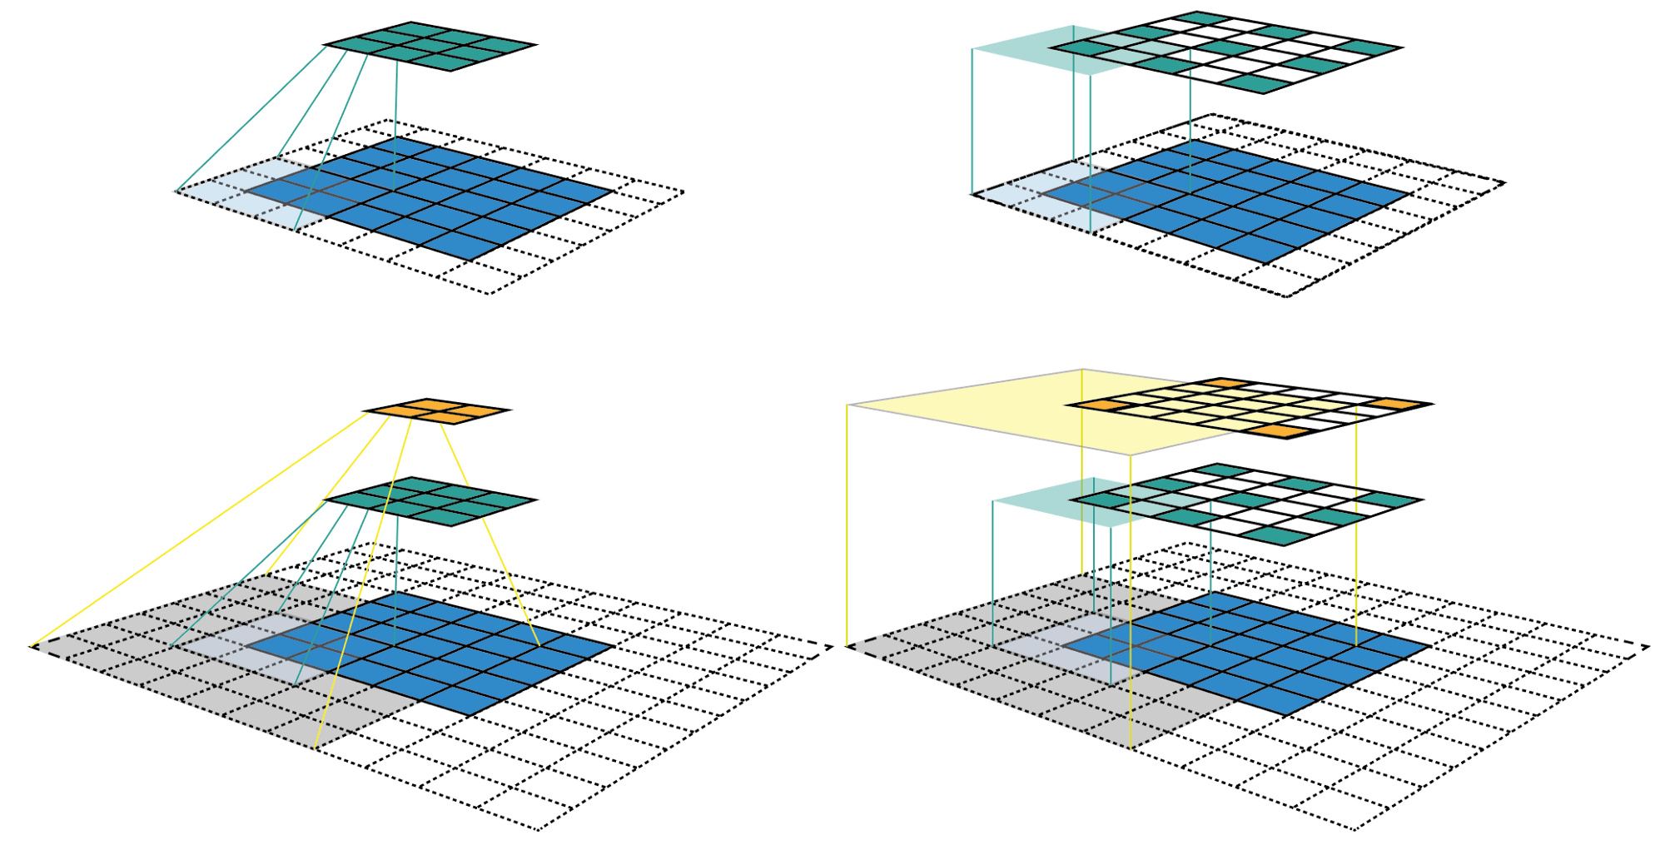
Network - II
Image Input Layer(152x152)
Convolution Layer(3x3, 1)
ReLU Layer
Normalization Layer
Max Pooling Layer
Fully Connected Layer
Regression Layer
3

Slide 45
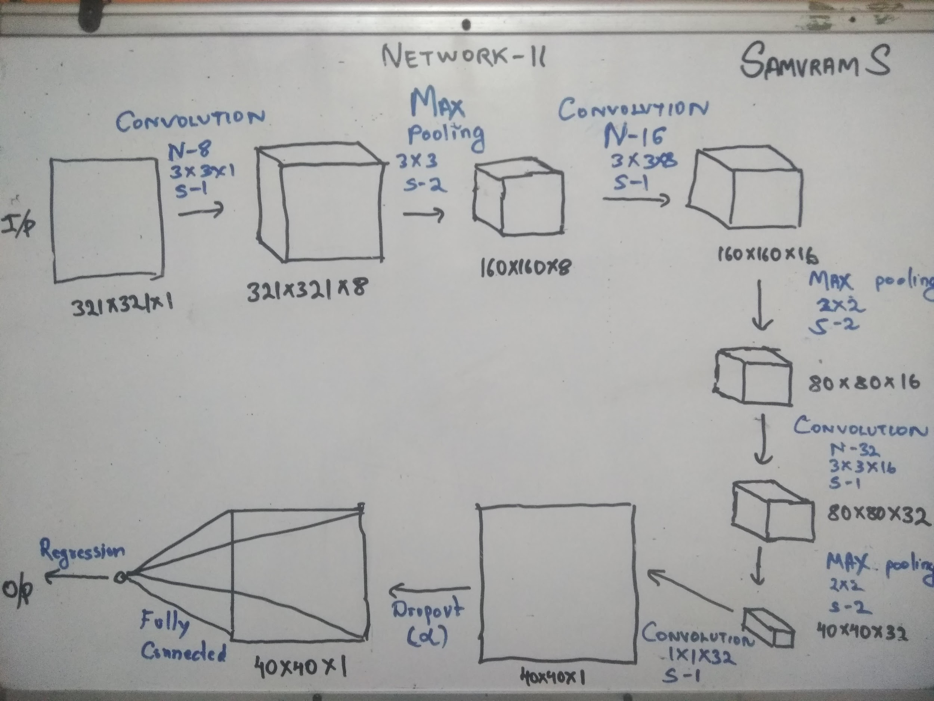

Slide 46
Network - 2
A contrast to network 1, by replacing average pooling with max pooling.
On comparing the results of Network-1 and Network 2 we can determine which pooling is better suited for our use.
Ɑ is also needed to be tuned for this network and is expected not to vary much.

Slide 47
Network - III
Image Input Layer(152x152)
Convolution Layer(3x3, 1)
ReLU Layer
Normalization Layer
Better of Avg/Max Pooling Layer
Fully Connected Layer
Regression Layer
4

Slide 48
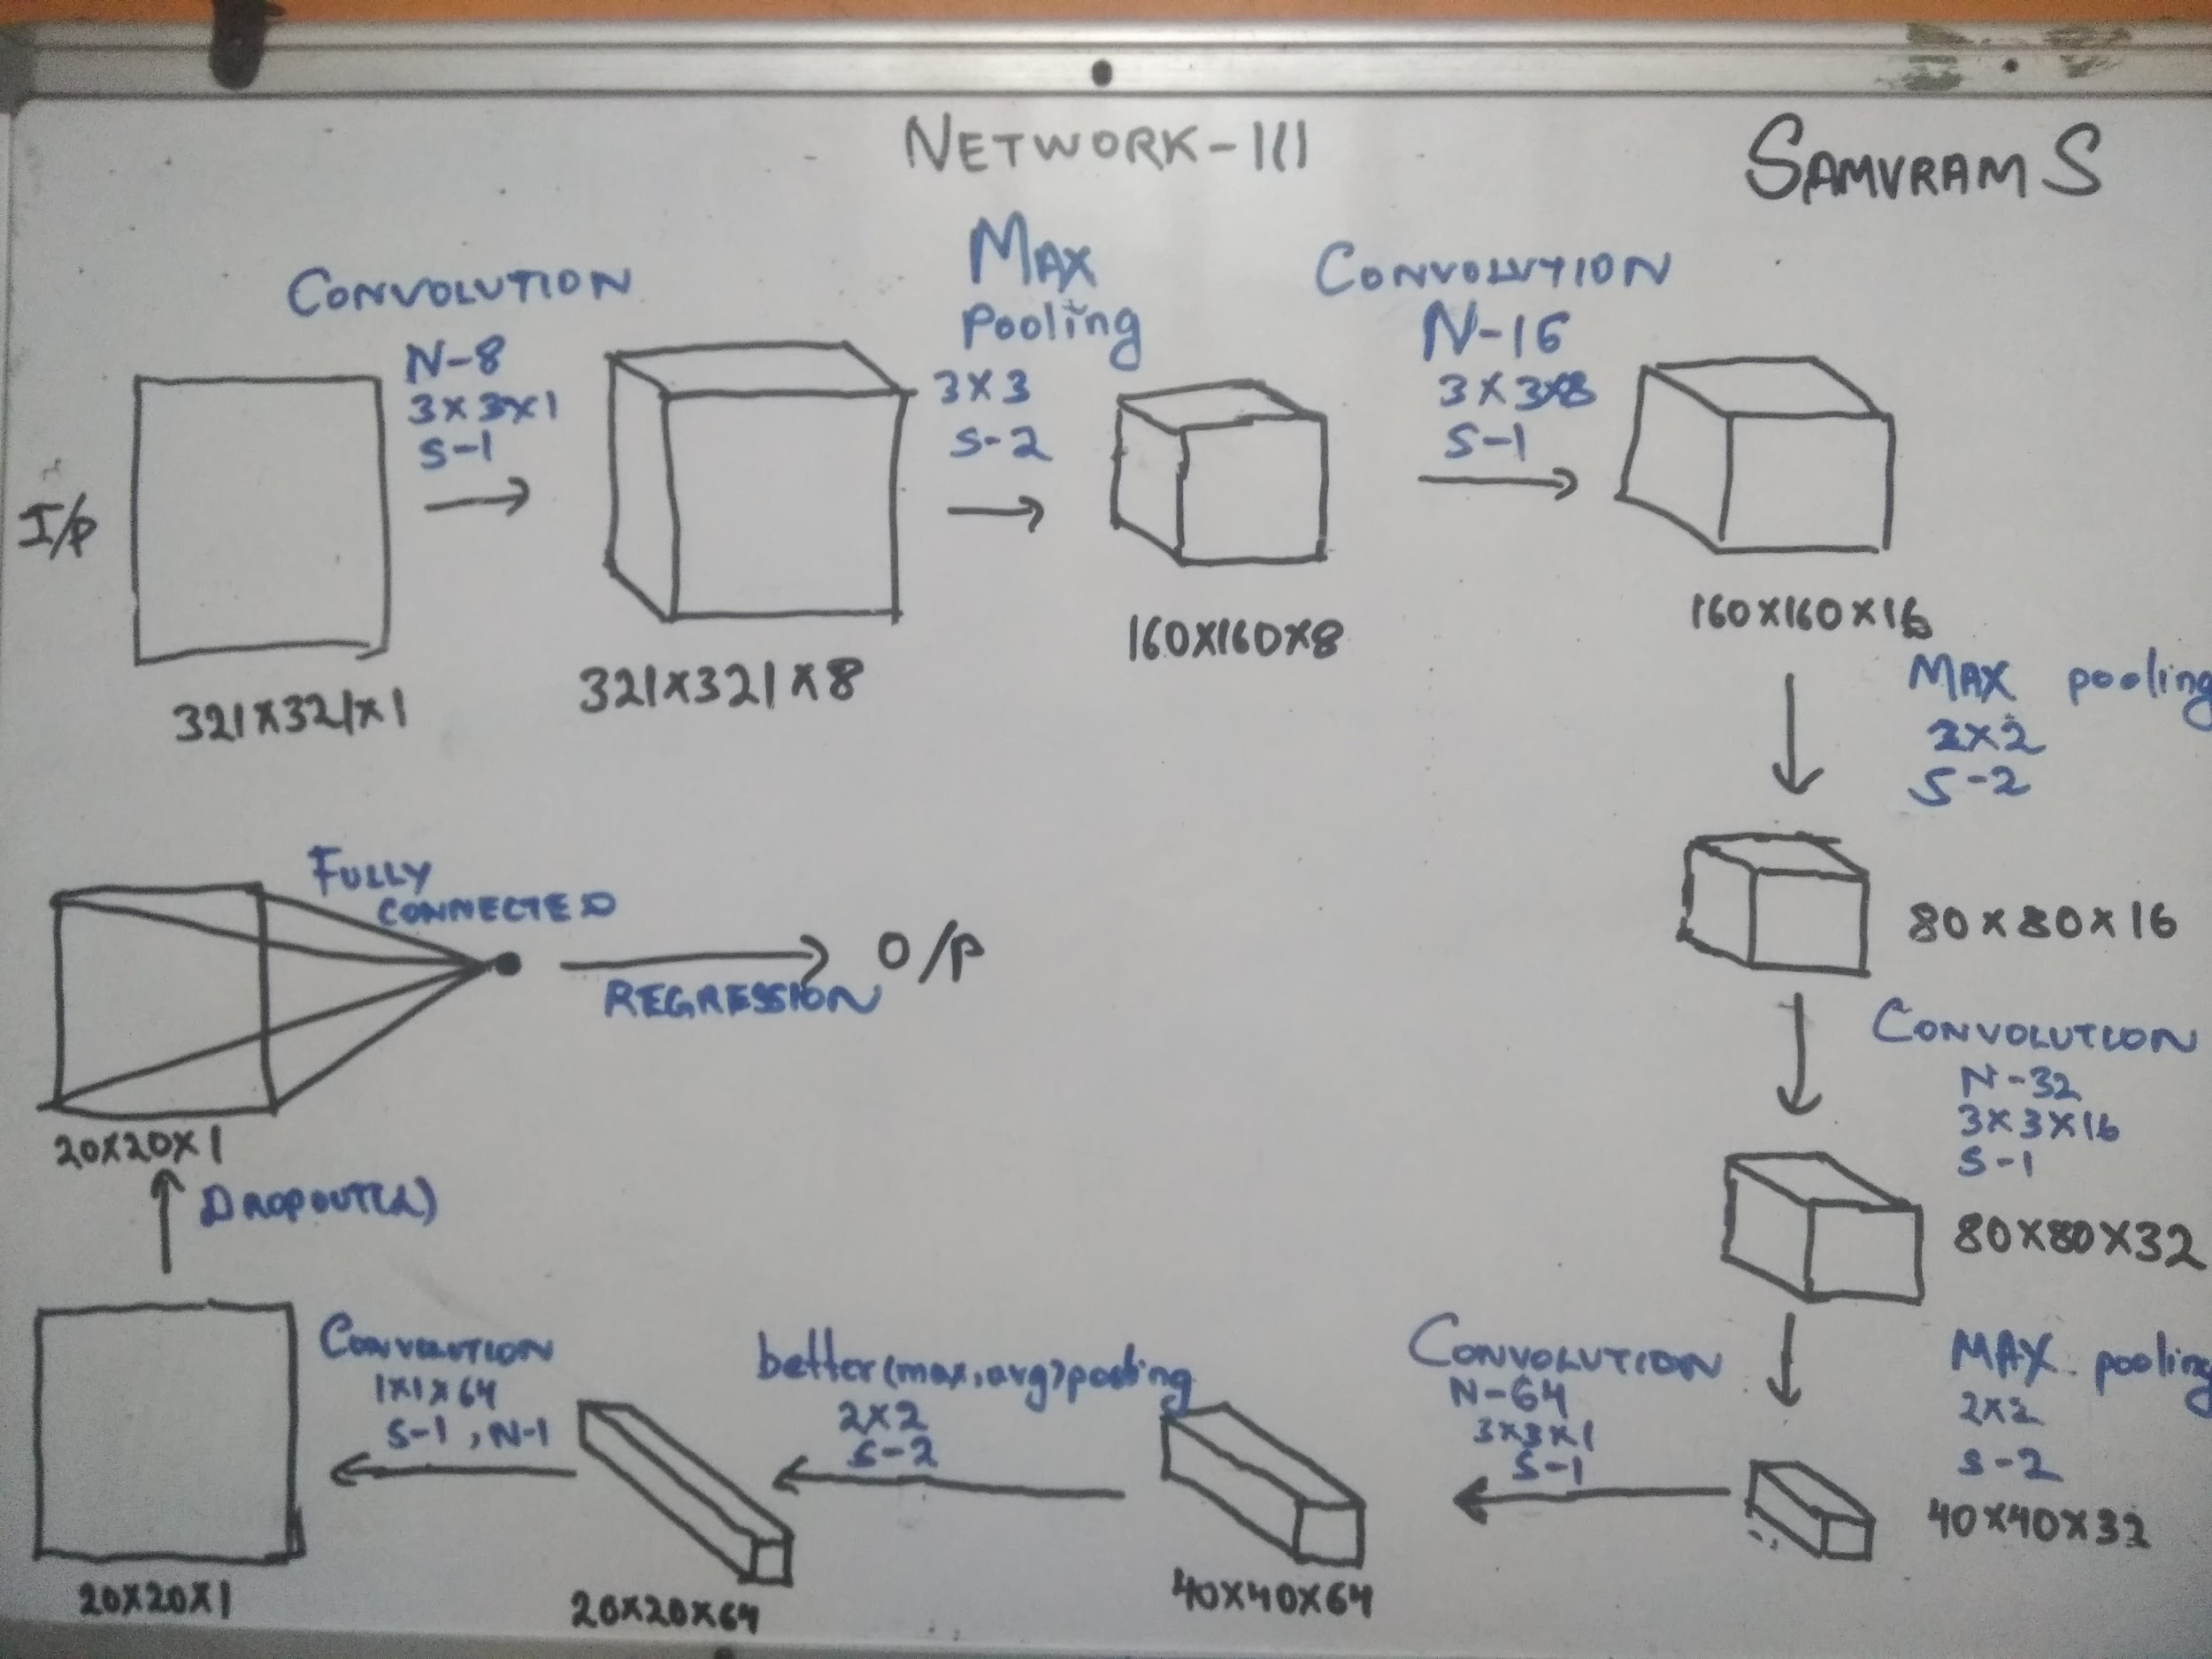

Slide 49
Network - 3
A contrast to network 1 & 2, to see the results of increasing depth of the CNN.
On comparing the results of Network-1,2 and Network 3 we can determine if the depth can be increased further without affecting the accuracy.
Ɑ is also needed to be tuned for this network and is expected not to vary much.

Slide 50

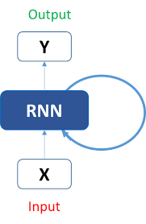
“There is a flaw in this model,
It does not depend on previous
value”
In a meeting with our Guide
Yes, this is bound to give a better result
We will learn it in future and apply

Slide 51
Network - IV
Image Input Layer(152x152)
Convolution Layer(3x3, 1)
ReLU Layer
Normalization Layer
Max Pooling Layer
Fully Connected Layer
RNN/GRU Layer
Regression Layer
NOT IMPLEMENTED!
3

Slide 52

Highly experimental
A recurrent neural network (RNN) is a class of artificial neural network where connections between nodes form a directed graph along a sequence. This allows it to exhibit temporal dynamic behavior for a time sequence.
A go at R-CNN for using the memory of previous predictions to correct and better the readings

Slide 53
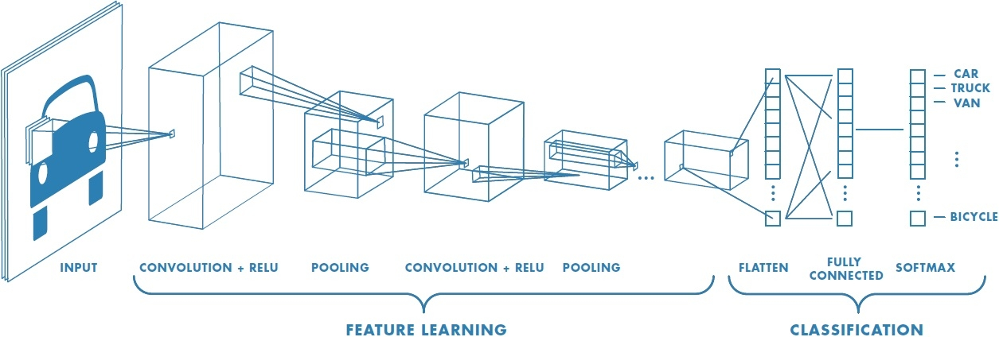
Practical insight
RMSE = 15.636 km
After tuning, and making some changes to few training loops,
RMSE = 10.386 km
CNN for Regression
Range
CNN
Regressor

Slide 54
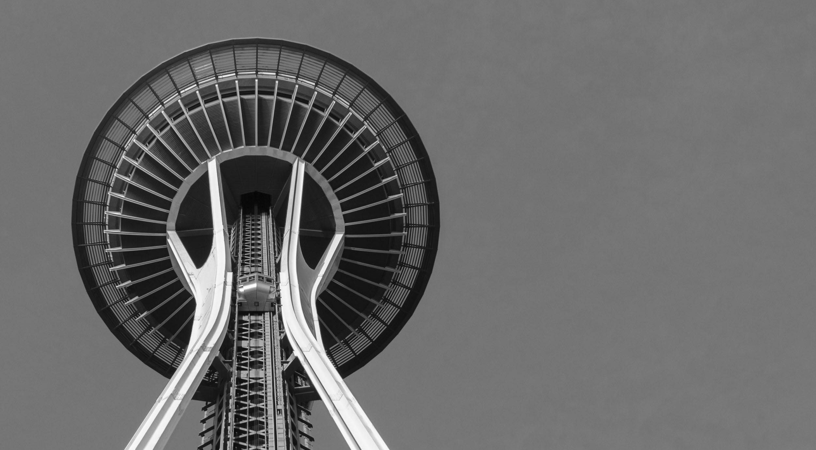
RESULTS
&
INFERENCES

Slide 55
Assumption : Each frame when analysed provides a value of range independent of the other frames
RANGE
RANGE
RANGE
This assumption is not true, as the range has a dependency on the previous frame value, which shows RNNs would be a better fit at solving the above problem.

Slide 56
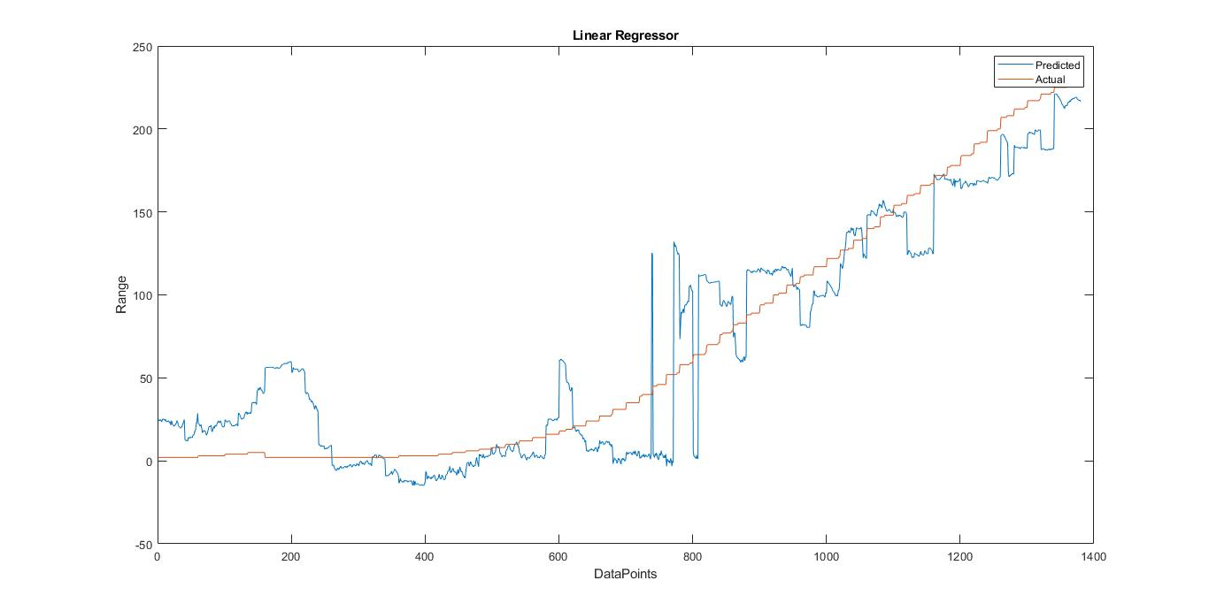
Inference - The map from the feature space to Range has some complexities (non-linearities) which a linear regressor fails to capture
Hence we move on to SVM class of regressors.

Slide 57
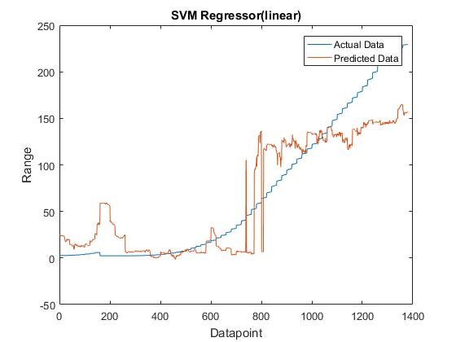
Inference -
SVMs do not perform well on highly skewed/imbalanced data sets. These are training data sets in which the number of samples that fall in one of the classes far outnumber those that are a member of the other class. Customer churn data sets are typically in this group because when you collect the training set, among a million customers during a particular time period, there would be very few who have actually churned .
SVMs are also not a good option especially if you have multiple classes. Ultimately in this case, you get back to a binary classifier and then use some kind of a voting mechanism to classify a sample to one of the classes.

Slide 58
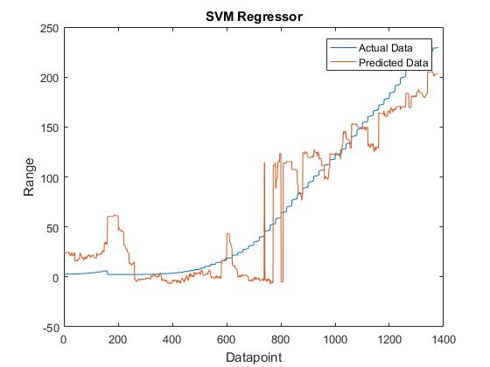
Inference -
Non-linear SVMs perform better proving a complex non-linearity exists in the system. This in line with the previous observation we had.
Hence we proceed to capture complex nonlinearities using ANN and Tree Regressor.

Slide 59
Inference -
Non-linear SVMs perform better proving a complex non-linearity exists in the system. This in line with the previous observation we had.
Hence we proceed to capture complex nonlinearities using ANN and Tree Regressor.

Slide 60
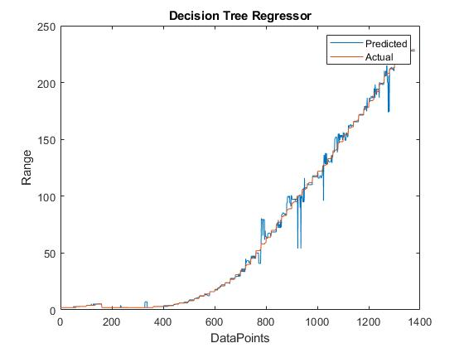
Inference -
Decision tree regressor has produced best fits till now only because the training dataset and test dataset are more or less from the same video.
The scalability of this architecture is a big issue, hence we move to ANN regressor.

Slide 61
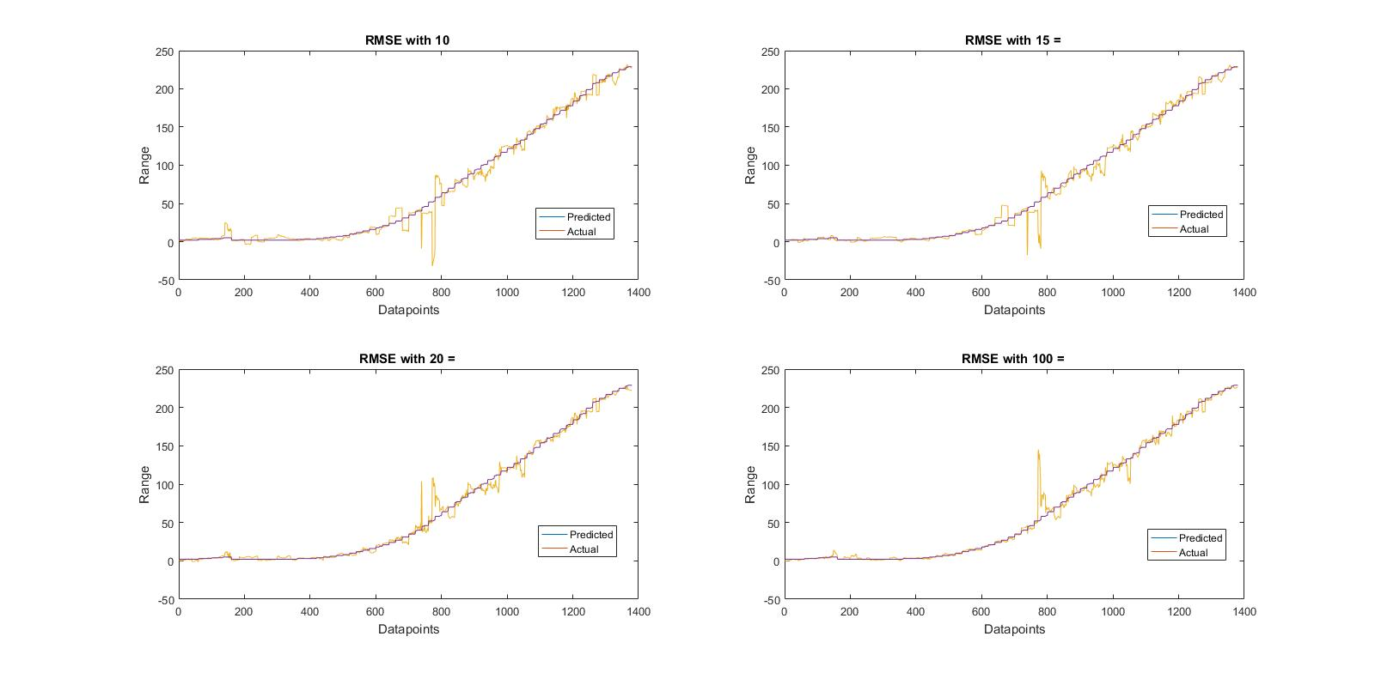
Inference -
ANNs are tuned by trial and error and are capable of capturing very complex non-linearities.
The results suggest a network architecture with 20 neurons in the hidden layer seems to outperform the other architectures.

Slide 62
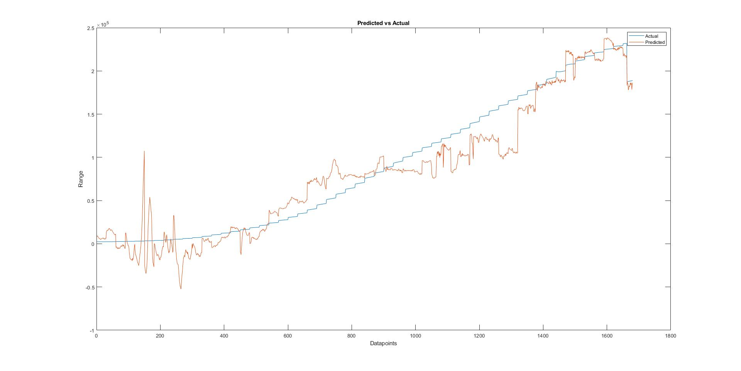
Inference -
CNNs are best known for their generalization power when compared to other models. Incidentally, they also deliver state of the art results for recognition/classification tasks.
However the network is supposedly delivering generalisation at the cost of accuracy in our case.

Slide 63
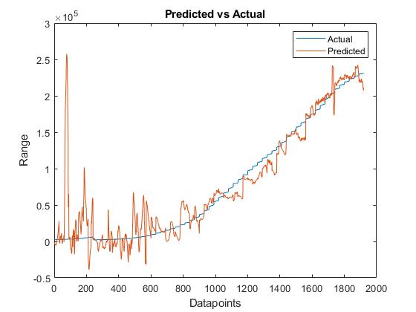
Inference -
When complexity of CNN is reduced, i.e. a layer from the architecture is removed, we see the CNN performs well on larger ranges and performs very poorly on the smaller ranges.
This seems natural, as at the initial stages, active propulsion systems emitt plumes which work as noise, for CNN.

Slide 64
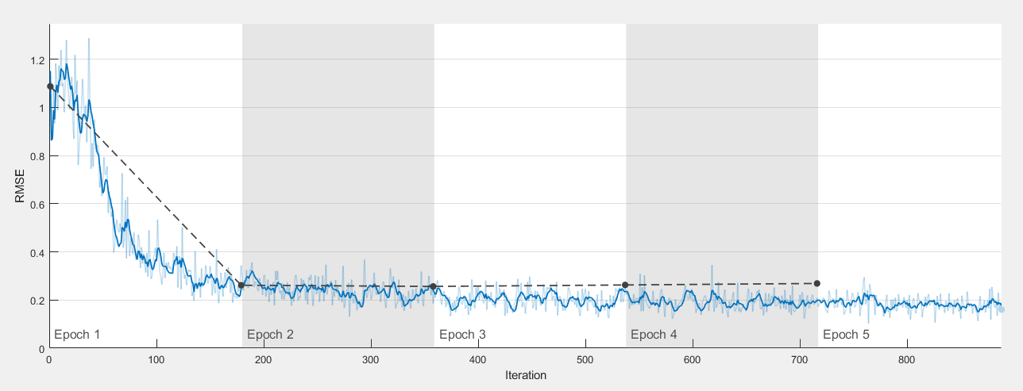
Inference -
We cannot make the depth of the architecture huge, as the model tends to overfit, as seen.
In this figure, after 2nd Epoch onward, the training RMSE decreases where as Validation RMSE increases.
This suggests the network is memorizing the training cases, and is a bad solution.

Slide 65
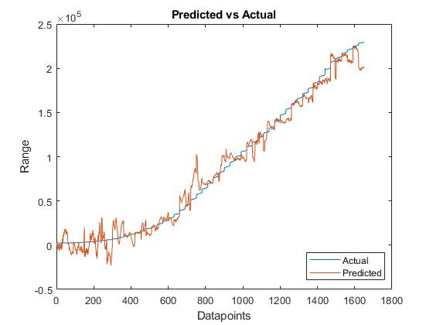
Inference -
After all the above observations, this is the best achieved results from the chosen architecture.
Key observation is that the CNN works very well for all the range values which was not the case earlier.

Slide 66
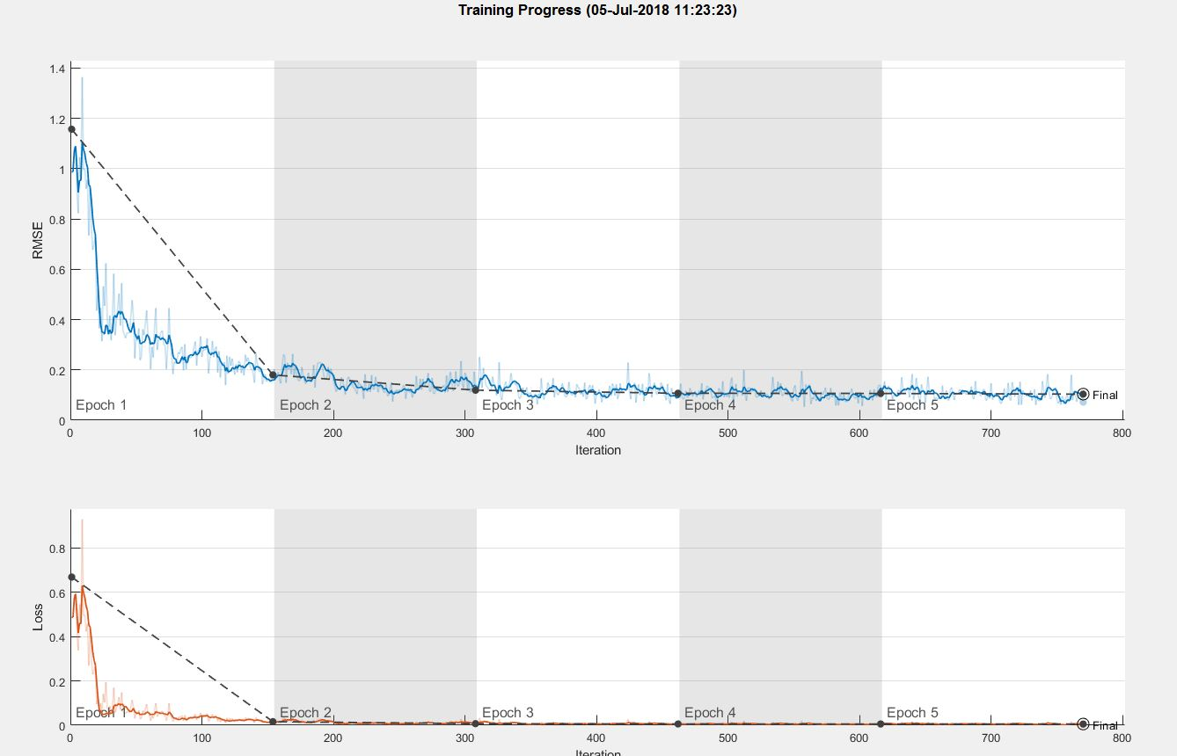
Inference -
Though we see a similar start in rmse and loss data as before, but the values goes to zero very fast and stays very low throughout the training.
Key observation is that the CNN never goes into overfitting in this case.
The RMSE value for this case was the lowest and equal to 10.35.

Slide 67
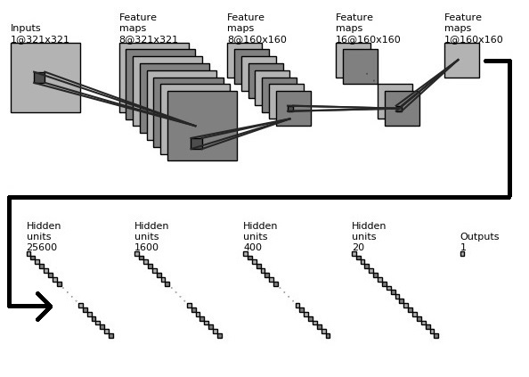
Final Architecture

Slide 68
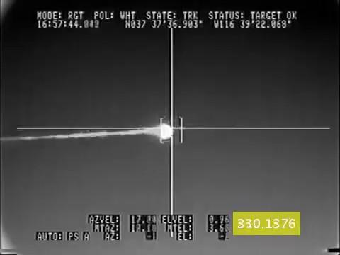
We have come up with a script which takes a video input, and frame by frame regresses the range which is then stamped. The ranges which are stamped, are also plotted in the next figure!

Slide 69
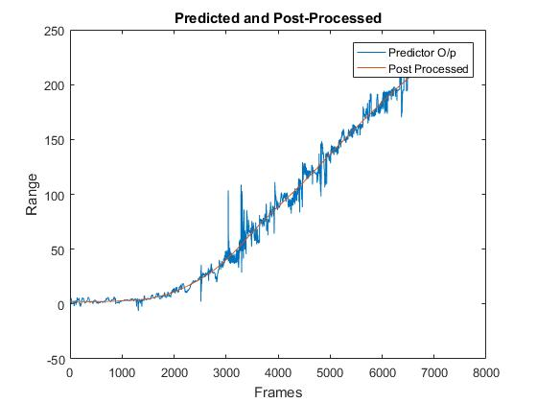

Slide 70

Pre Convolution Post Convolution
The filters of the first layer have been visualised and as you can see in this image some kind of derivative has been taken. These are learned automatically by the CNN.

Slide 71
^{Where do we stand?}
The CNN approach needs to be fine tuned.
The regressors and the data scrapers need to be combined for a working solution!

Slide 72
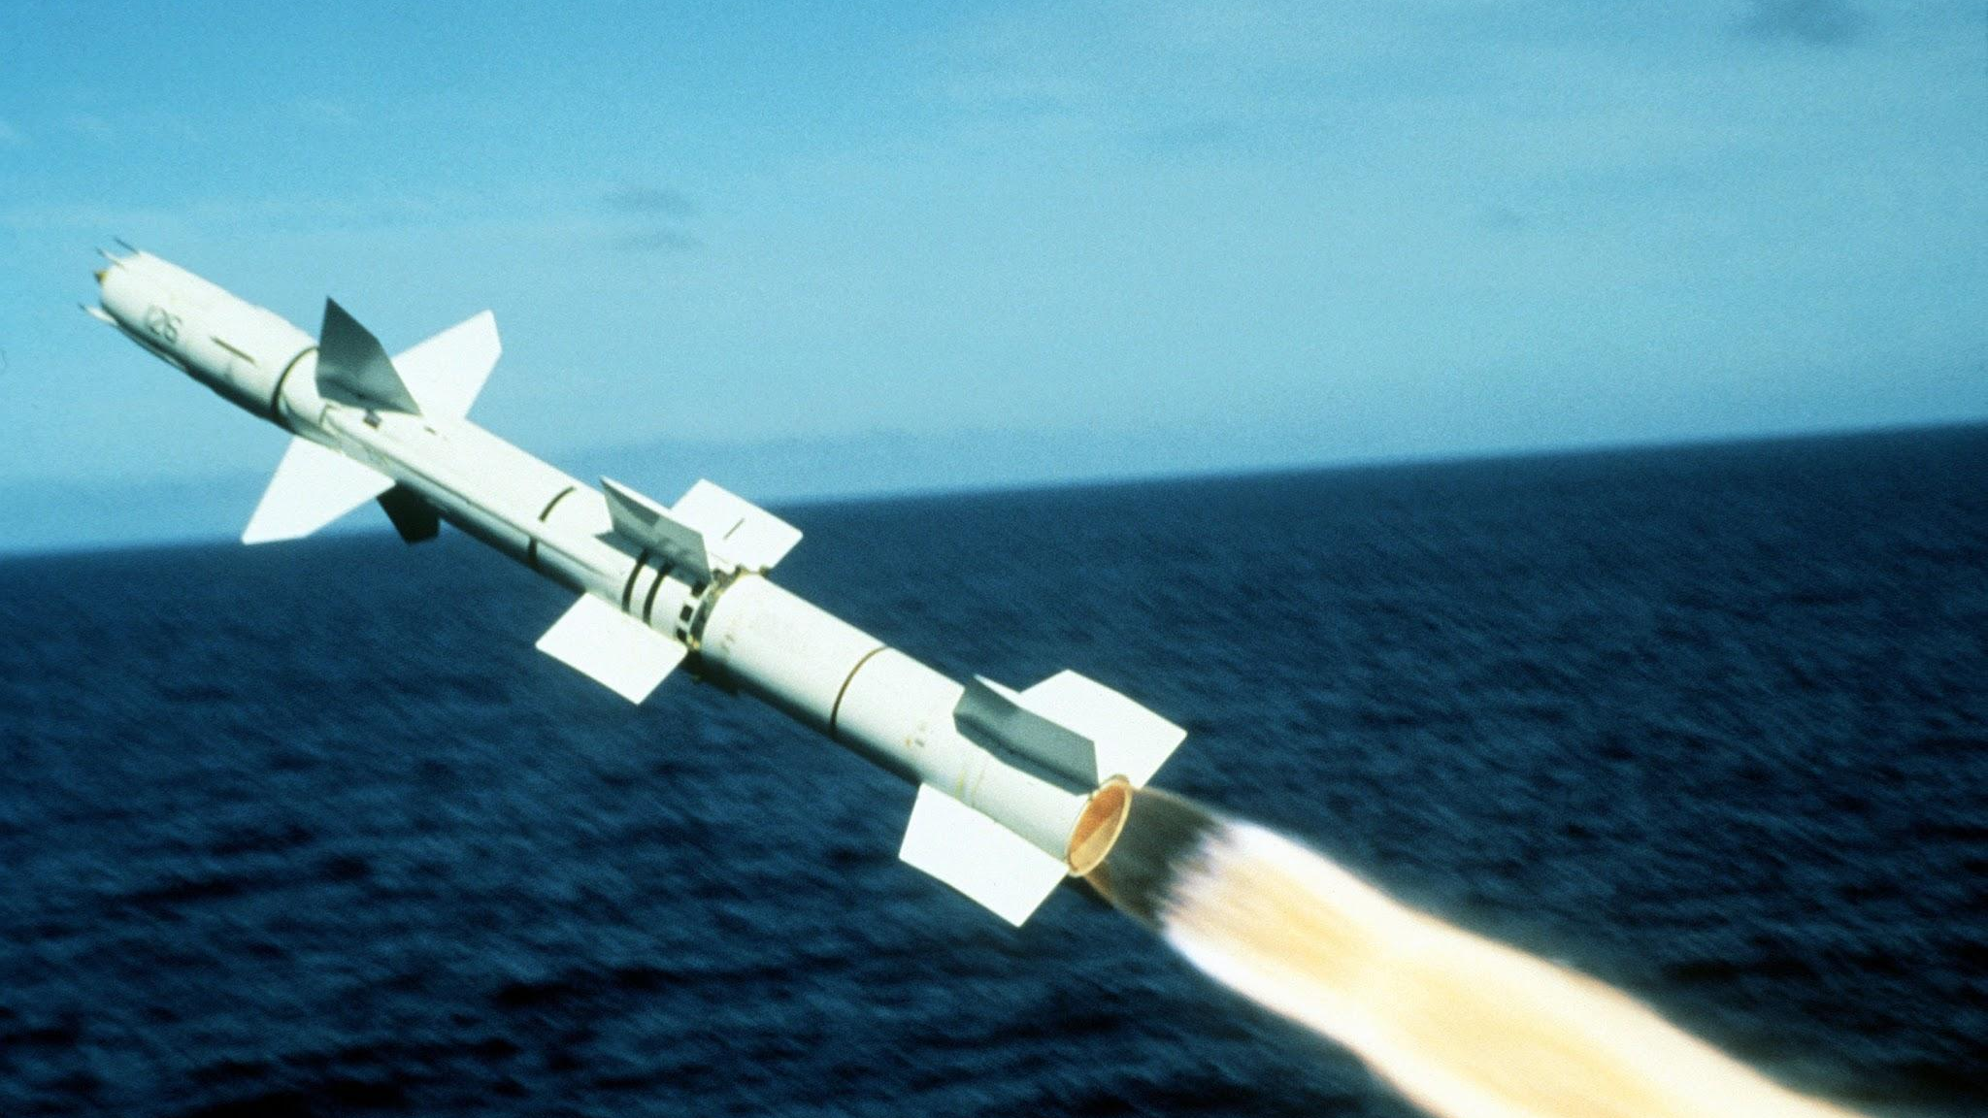
Advantages of CNN over traditional methods of range regression
Fog
Atmospheric aberrations
Site selection
Mode of Tracking
IR fluctuations

Slide 73
Plan of Action
Fine tune the CNN, to operate for large ranges.
Use the Decision Tree Classifier for short ranges.
Find an optimal range separating the region of operation of both the methods.
Combine the results, and discuss merits and demerits

Slide 74
Timeline of Internship
21st May
Joining Date
Finding a department to intern in, and deciding the problem statement
1st June
Literature Survey
Started studying and finding about the existing system, explored the industrial usage
7th June
Data mining begins
Formation of dataset is essential for the part of ML/Deep Learning applications
15th June
Implementation of Methods
Various methods were implemented and inferenced parallely, the insight was important
5th July
Submission of Code
All codes, and data submitted back for evaluation and HDDs cleaned

Slide 75
The wheels are in motion...
We have also submitted a paper for publication in IEEE - Recent Advances in Intelligent Computational Systems (RAICS) - 2018.
Current Status - Under Review
Ms. Sasmita Mahakud, JRF at DRDO is pursuing this line of work and working on NN with memory to enhance our results, and we hope we can implement it sooner or later.

Slide 76

Thank You

